Slide 1
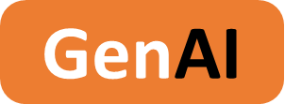

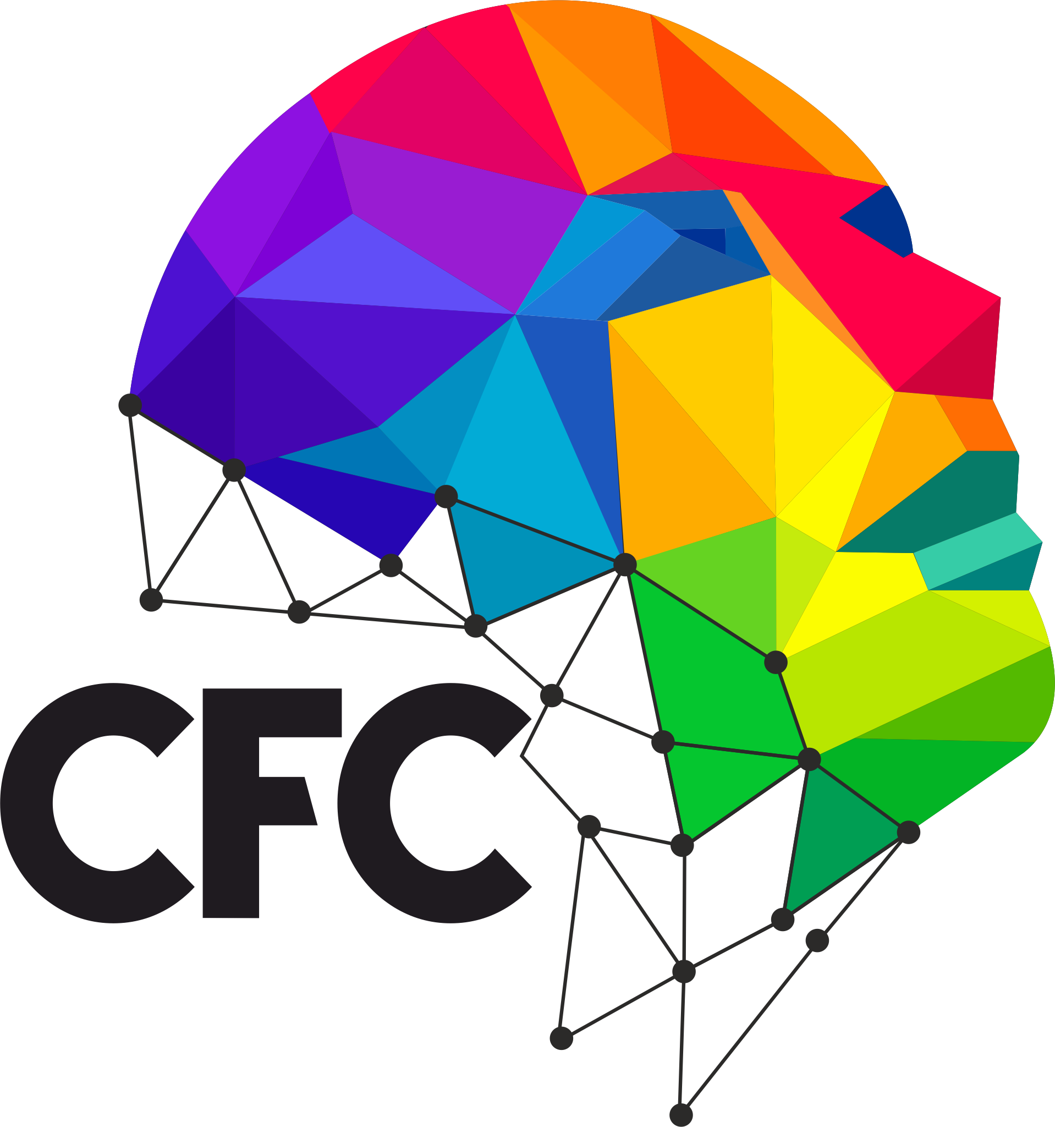
Crop Recommendation System 2024 - 2025
Utilizing GenAI and Machine Learning for Comprehensive Crop Recommendation System
GenAI-2024-2025-B2-00X
GenAI-2024-2025-B2

Slide 2
Project Name
GenAI-2024-2025-B2-00X
Team Information
Name. Initial
Name. Initial
Name. Initial
Name. Initial
Student Team
Acad. Yr, Department
Institution
Role(s) Played
Acad. Yr, Department
Institution
Role(s) Played
Acad. Yr, Department
Institution
Role(s) Played
Acad. Yr, Department
Institution
Role(s) Played
Name. Initial
Name. Initial
Name. Initial
Faculty
DT Mentor
Technology Mentor
Project Guide

Slide 3
Project Name
GenAI-2024-2025-B2-00X
Project Overview
Requirement / Problem statement
Crop Recommendation plays a crucial role in agriculture, aiming to optimize crop selection based on environmental factors and soil properties. The challenge lies in accurately predicting suitable crops using diverse data sources, including soil nutrients, weather patterns, and historical yields, while generating detailed reports to guide farmers in improving productivity and sustainability.
Description
This project introduces an AI-powered system for accurate crop recommendation, delivering comprehensive reports that detail suitable crops, underlying soil conditions, and strategies for enhancing yield. It empowers farmers and agricultural professionals with actionable insights, optimizing productivity, reducing resource wastage, and supporting sustainable farming practices.
Scope
GenAI | AI
Develop an AI-powered system for accurate crop recommendation, providing comprehensive reports to assist farmers and agricultural professionals in optimizing crop selection, improving yield, promoting sustainable practices, and reducing resource utilization for enhanced agricultural productivity.
AI identifies, analyzes, and produces reports.
Key factors & features
Target Audience
Domain
Agriculture, agri-tech, crop management, AI-driven farming solutions, precision agriculture, and sustainable farming practices.
AI-driven prediction, actionable crop recommendations, soil and climate analysis, yield optimization, and sustainable agricultural practices.
Farmers, agricultural consultants, agronomists, agricultural institutions, and policymakers in the agriculture sector.

Slide 4
Project Name
GenAI-2024-2025-B2-00X
Project Features
Project Features / Journeys
Features
Automated Crop Recommendation: Predicts suitable crops using soil and climatic data.
Detailed Agricultural Reporting: Provides comprehensive reports detailing soil health, crop suitability, and farming strategies.
Advanced Generative AI Insights: Utilizes Generative AI to synthesize actionable agricultural advice and interpret complex data.
Intuitive User Interface: Offers an easy-to-use platform for farmers to input data and access recommendations.
Epics
Soil and Climate Analysis: Develops ML models to analyze environmental factors and optimize crop selection.
Crop Recommendation Reporting: Generates detailed reports with insights into soil management and crop planning.
User Stories
As a farmer, I need to input soil and climate data to receive crop recommendations.
As an agronomist, I require synthesized reports for guiding sustainable farming practices.
As an agriculture policy analyst, I analyze recommendation trends to improve regional agricultural strategies.

Slide 5
Project Name
GenAI-2024-2025-B2-00X
Project Features
Project Features / Journeys
Journeys
Crop Data Submission Journey
User submits soil and climate data: Users upload data such as nitrogen, phosphorus, potassium levels, temperature, and rainfall.
AI model predicts suitable crops: The AI evaluates the data to recommend the most suitable crops for the given conditions.
Recommendation Reporting Journey
Generative AI synthesizes insights: Generative AI processes the ML predictions to generate an actionable report.
Report outlines crop suitability and farming strategies: The report includes recommended crops, soil health analysis, and suggestions for improving yield.
Soil Management Suggestion Journey
Tailored recommendation based on soil health: The system provides specific advice for enhancing soil quality and optimizing crop growth
Use Cases
Upload and Analyze Data: Users input soil and climate parameters, triggering the crop prediction model.
View Recommendation Report: Users review a detailed report highlighting crop suitability and soil health insights.
Access Soil Improvement Tips: Users receive personalized advice for improving soil conditions and maximizing agricultural productivity.

Slide 6
Project Name
GenAI-2024-2025-B2-00X
Technology Stack
Presentation Layer
Methodology
Gradio (for user interface)
Appraoch: Supervised ML for crop recommendation, GenAI for report synthesis.
Models: Machine Learning classification model, GenAI for diagnostic reporting
Application Layer
Products, Tools & Utilities
Python (primary language), Tensoflow and Scikit-learn (for ML Model implementation)
Products: Llama3 (for generative AI model)
Utilities: Pandas, Numpy and Seaborn (for data preprocessing), Tensorflow and Scikit-learn (for ML utilities), Gradio (for frontend interface)
Data Layer
Pandas and Numpy (for data processing)
Infrastructure
Hosted on Hugging Face Spaces with base CPU instance at free tier.
Source Code
API
Project code repository is available at Link
Groq API for accessing Llama3 LLM
Note: Artefacts locations are provided as clickable hyperlink available as “Link”

Slide 7
Project Name
GenAI-2024-2025-B2-00X
Wireframe | UI
Wireframe | UI
Provide journey / stories / use case wise navigable Wireframes / UI screenshots. Figma or similar approaches preferred.

Slide 8
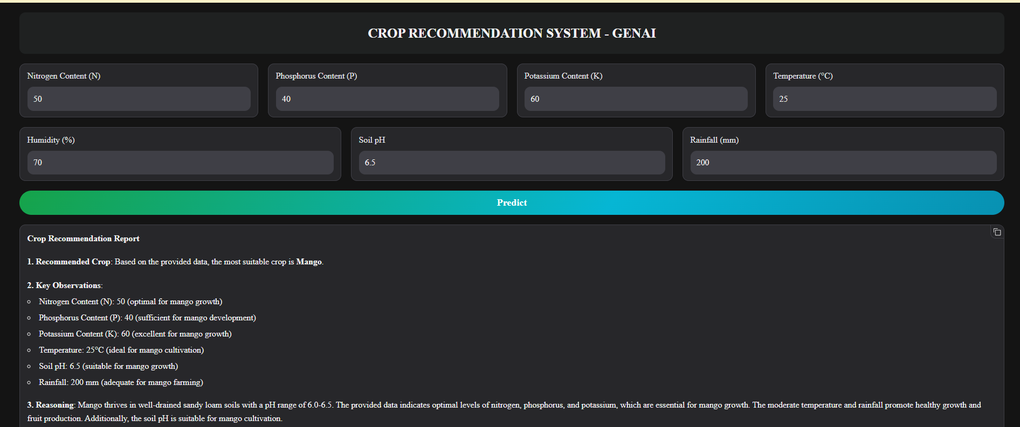
Project Name
GenAI-2024-2025-B2-00X
Application Screenshots
Application Screenshots

Slide 9
Project Name
GenAI-2024-2025-B2-00X
Project / Product Roadmap
Project / Product Roadmap | Milestones | Features
Short Term | Mid Term | Long Term
Develop the crop recommendation prediction model. Integrate soil and climate data into the system. Generate initial crop suitability reports. | Refine Generative AI for precision in recommendation reports. Create an intuitive dashboard for user interaction. Incorporate best farming practices and soil improvement tips in reports. | Implement global cloud deployment for accessibility. Analyze longitudinal agricultural trends across regions. Support multilingual recommendation report generation for diverse users.

Slide 10
Project Name
GenAI-2024-2025-B2-00X
Artefacts
Project Portal
Wireframe | UI
Project Portal / website is available at Link
Project wireframe / UI designs are available at Link
Presentation
Application
Project presentation (this document) is available at Link
Application is available at Link
Requirement Document / Specification
DT Playbook
Project requirement document / specification is available at Link
Project DT Playbook is available at Link
Technical Document / Specification
Overview Video
Project technical document / specification are available at Link
Project overview video is available at Link
Video provides project overview, presentations, journey wise Wireframe, UI, application demo as required and as applicable.
Source Code
Project code repository is available at Link
Note: All links are provided as clickable hyperlink available as “Link”

Slide 11
Project Name
GenAI-2024-2025-B2-00X
Thanks
Thanks

